Slide 1

A Story on DNS Attacks
Once Upon a Time in the West
VALENTINA PALACIN
RUTH ESMERALDA BARBACIL

Slide 2


-[
Say, Who?
]-
Threat Library Team
Deloitte Argentina’s Threat Library Team –
We gather information about cyber operations being carried across the world to analyze the Motivations, Tools, Tactics and Procedures used by the Advanced Persistent Threats. We aid researchers understand and defend themselves against cyber threats around the globe.

Slide 3


-[
So, what?
]-
Agenda
The Bullets
DNS Attacks 2007-2019
The Gunmen
Guns In Data
Dodging The Bullets

Slide 4


-[
The Guns
]-
Mitre ATT&CK Framework
Mapping Tools, Tactics, Techniques and Procedures with ATT&CK Framework
«ATT&CK™ for Enterprise is an adversary model and framework for describing the actions an adversary may take to compromise and operate within an enterprise network.»

Slide 5
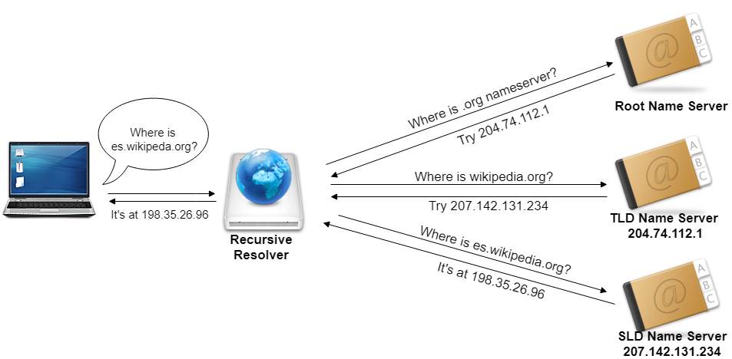

Slide 6



-[
The Bullets
]-
DNS Tunneling
DNS Hijacking
DNS Poisoning
Use of DNS as a covert communication channel to bypass a firewall
Manipulation of DNS queries resolutions to redirect users
to malicious sites
Corrupted data is introduced into the DNS resolver's cache to make it return a different result

Slide 7
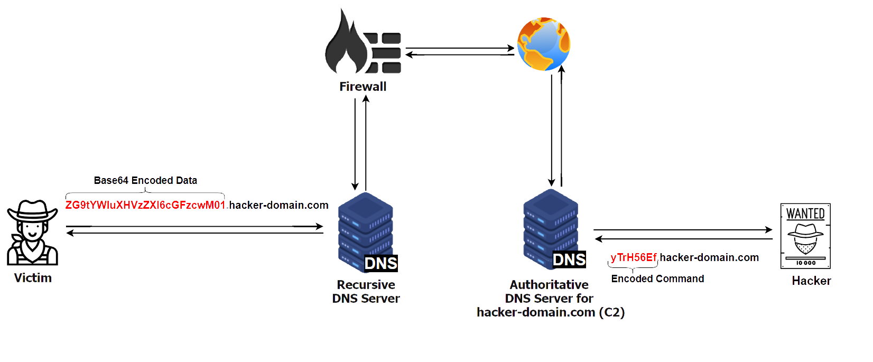
DNS TUNNELING EXAMPLES

Slide 8
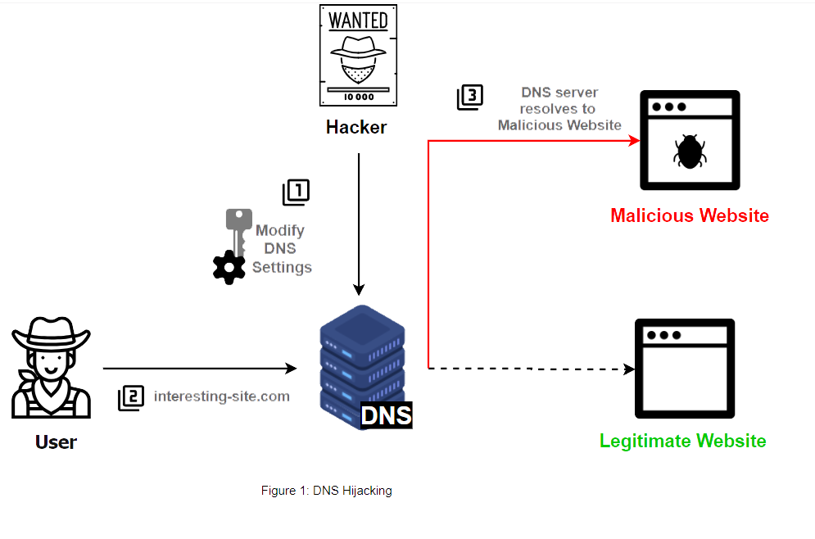
DNS HIJACKING EXAMPLE

Slide 9
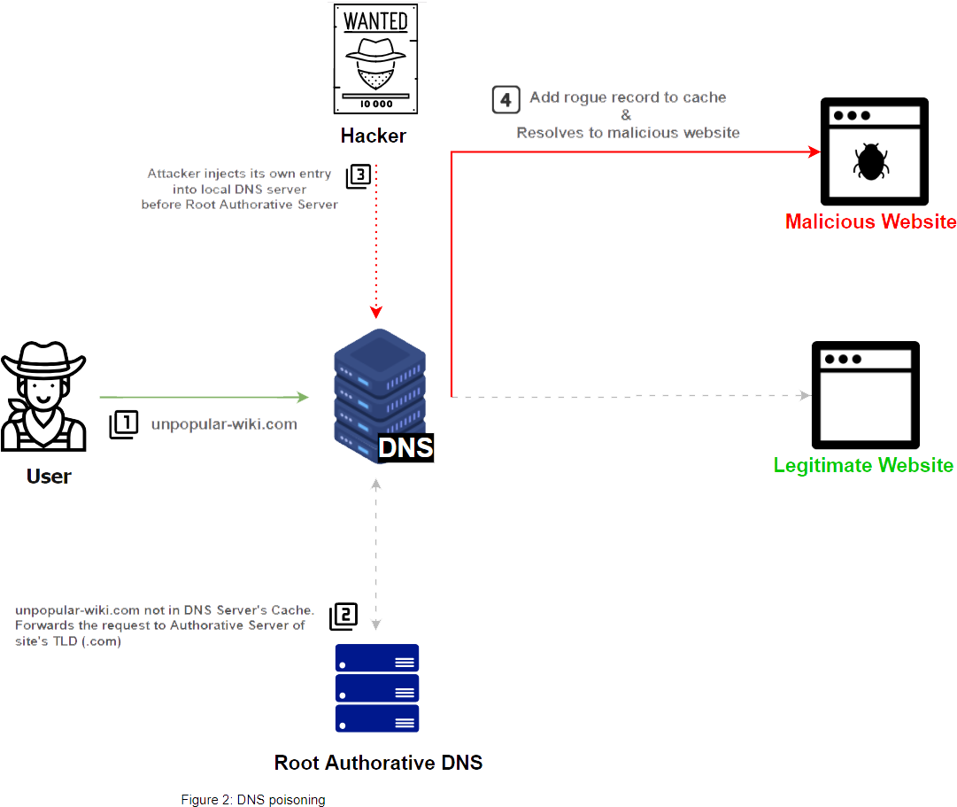
DNS POISONING EXAMPLE

Slide 10
DNS ATTACKS 2007 UNTIL NOW
Massive attack on Brazilian DSL Modems
Operation Poison Hurricane
Operation Ghost Clic
DNSChanger
Julie Amero Conviction
TDSSLoader
Craiglist Hijacked
Linux/C.dorked.A
APT3 Targets US Government
Ngrbot
Linux/Ebury
2007
2008
2009
2010
2011
2012
2013
2014
2015
2016
Win32/RBrute
Google Defense
The Great Cannon
Syrian Electronic Army
ZLOB Targets Search Enginees
Malicious Java Applet
Web-based attack targets home routers in Brazil
Yispecter
RoTLD Compromised
Iranian Cyber Army Targets Baidu & Twitter

Slide 11
THE JULIE AMERO CASE
Massive attack on Brazilian DSL Modems
Operation Poison Hurricane
Operation Ghost Clic
DNSChanger
Julie Amero Conviction
TDSSLoader
Craiglist Hijacked
Linux/C.dorked.A
APT3 Targets US Government
Ngrbot
Linux/Ebury
2007
2008
2009
2010
2011
2012
2013
2014
2015
2016
Win32/RBrute
Google Defense
The Great Cannon
Syrian Electronic Army
ZLOB Targets Search Enginees
Malicious Java Applet
Web-based attack targets home routers in Brazil
Yispecter
RoTLD Compromised
Iranian Cyber Army Targets Baidu & Twitter

Slide 12
OPERATION GHOST CLICK
Massive attack on Brazilian DSL Modems
Operation Poison Hurricane
Operation Ghost Clic
DNSChanger
Julie Amero Conviction
TDSSLoader
Craiglist Hijacked
Linux/C.dorked.A
APT3 Targets US Government
Ngrbot
Linux/Ebury
2007
2008
2009
2010
2011
2012
2013
2014
2015
2016
Win32/RBrute
Google Defense
The Great Cannon
Syrian Electronic Army
ZLOB Targets Search Enginees
Malicious Java Applet
Web-based attack targets home routers in Brazil
Yispecter
RoTLD Compromised
Iranian Cyber Army Targets Baidu & Twitter

Slide 13
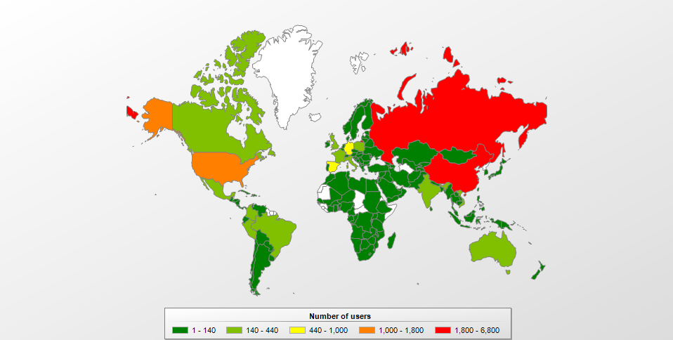
-[
DNS Attack History
]-
Securelist (Kaspersky) – Is it the end of the DNSChanger Trojan?
Operation
Ghost Click
4 million computers affected
U$D 14 million through click hijacking
6 Estonian arrested
FBI seized rogue servers

Slide 14
JUST FOR THE GLORY
Massive attack on Brazilian DSL Modems
Operation Poison Hurricane
Operation Ghost Clic
DNSChanger
Julie Amero Conviction
TDSSLoader
Craiglist Hijacked
Linux/C.dorked.A
APT3 Targets US Government
Ngrbot
Linux/Ebury
2007
2008
2009
2010
2011
2012
2013
2014
2015
2016
Win32/RBrute
Google Defense
The Great Cannon
Syrian Electronic Army
ZLOB Targets Search Enginees
Malicious Java Applet
Web-based attack targets home routers in Brazil
Yispecter
RoTLD Compromised
Iranian Cyber Army Targets Baidu & Twitter

Slide 15

-[
DNS Attack History
]-
Hacktivism
& Vandalism
Universities, Media & Social Networks
Gigya comments platform

Slide 16
BRAZIL HIJACKED
Massive attack on Brazilian DSL Modems
Operation Poison Hurricane
Operation Ghost Clic
DNSChanger
Julie Amero Conviction
TDSSLoader
Craiglist Hijacked
Linux/C.dorked.A
APT3 Targets US Government
Ngrbot
Linux/Ebury
2007
2008
2009
2010
2011
2012
2013
2014
2015
2016
Win32/RBrute
Google Defense
The Great Cannon
Syrian Electronic Army
ZLOB Targets Search Enginees
Malicious Java Applet
Web-based attack targets home routers in Brazil
Yispecter
RoTLD Compromised
Iranian Cyber Army Targets Baidu & Twitter

Slide 17

-[
DNS Attack History
]-
Security Land - New DNS Botnet Hijacked Over 100,000 Routers
Brazil
Hijacked
4,5 million routers affected

Slide 18
THE DRAGON AWAKENS
Massive attack on Brazilian DSL Modems
Operation Poison Hurricane
Operation Ghost Clic
DNSChanger
Julie Amero Conviction
TDSSLoader
Craiglist Hijacked
Linux/C.dorked.A
APT3 Targets US Government
Ngrbot
Linux/Ebury
2007
2008
2009
2010
2011
2012
2013
2014
2015
2016
Win32/RBrute
Google Defense
The Great Cannon
Syrian Electronic Army
ZLOB Targets Search Enginees
Malicious Java Applet
Web-based attack targets home routers in Brazil
Yispecter
RoTLD Compromised
Iranian Cyber Army Targets Baidu & Twitter

Slide 19
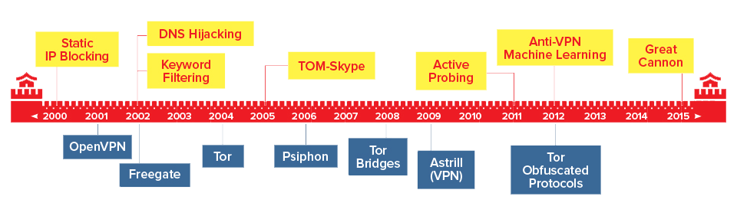
-[
The Great Firewall
]-
ThousandEyes – The Ongoing War Between China’s Great Firewall and Circumvention Tools
The
Great Cannon
2002
Redirected to
blocked IP addresses.
2015 - DDoS attacks.
Redirected to legitimate websites worldwide.

Slide 20
DNS ATTACKS 2016 UNTIL NOW
Sea Turtle
DNSpionage Suspected Iranian
OilRig Targets Saudi Arabia with Helminth
Project Sauron
FIN7 Targets Restaurant Industry
OilRig Uses QUADAGENT
DNSpionage
APT32 Targets Southeast Asia
RogueRobin
New Variant
NetNod
Compromised
FrameworkPoS
FIN7 Targets US SEC
Multigrain
OSX/MaMi
Switcher
OilRig Uses BONDUPDATER
APT32 Targets Cambodian interested people
OilRig Uses ISMInjector
BlackWallet.co Loses $400K
2016
2017
2018
2019
BernhardPoS
DNSMessenger
UDPoS
Kessel
DNS Hijacking in Venezuela
Cafax
Attacked
DNSUnlocker
OilRig Uses ISMAgent
DarkHydrus Uses RogueRobing
Denis Backdoor
US CERT Global Alert
Roaming Mantis New Variant
OilRig expands Targets
APT32 Targets Subsidiaries of US and Philippines
DNSpionage launches Karkaroff
OilRig Targets Middle East
Roaming Mantis
OilRig Uses ALMA Communicator

Slide 21
OILRIG CAMPAIGNS 2016-2019
Sea Turtle
DNSpionage Suspected Iranian
OilRig Targets Saudi Arabia with Helminth
Project Sauron
FIN7 Targets Restaurant Industry
OilRig Uses QUADAGENT
DNSpionage
APT32 Targets Southeast Asia
RogueRobin
New Variant
NetNod
Compromised
FrameworkPoS
FIN7 Targets US SEC
Multigrain
OSX/MaMi
Switcher
OilRig Uses BONDUPDATER
APT32 Targets Cambodian interested people
OilRig Uses ISMInjector
BlackWallet.co Loses $400K
2016
2017
2018
2019
BernhardPoS
DNSMessenger
UDPoS
Kessel
DNS Hijacking in Venezuela
Cafax
Attacked
DNSUnlocker
OilRig Uses ISMAgent
DarkHydrus Uses RogueRobing
Denis Backdoor
US CERT Global Alert
Roaming Mantis New Variant
OilRig expands Targets
APT32 Targets Subsidiaries of US and Philippines
DNSpionage launches Karkaroff
OilRig Targets Middle East
Roaming Mantis
OilRig Uses ALMA Communicator

Slide 22
OilRig
Suspected Iranian
POLITICAL, MILITARY ADVANTAGE & FINANCIAL GAIN
Expert
-[
Once Upon a Time

Slide 23
-[
The Guns
]-
OilRig - Toolset
T1193 - Spearphishing Attachment
T1008 – Fallback Channels
T1132 - Data Encoding (Base36 and Base64 encoding)
T1094 - Custom Command and Control Protocol (DNS A, AAAA, TXT Records)

Slide 24
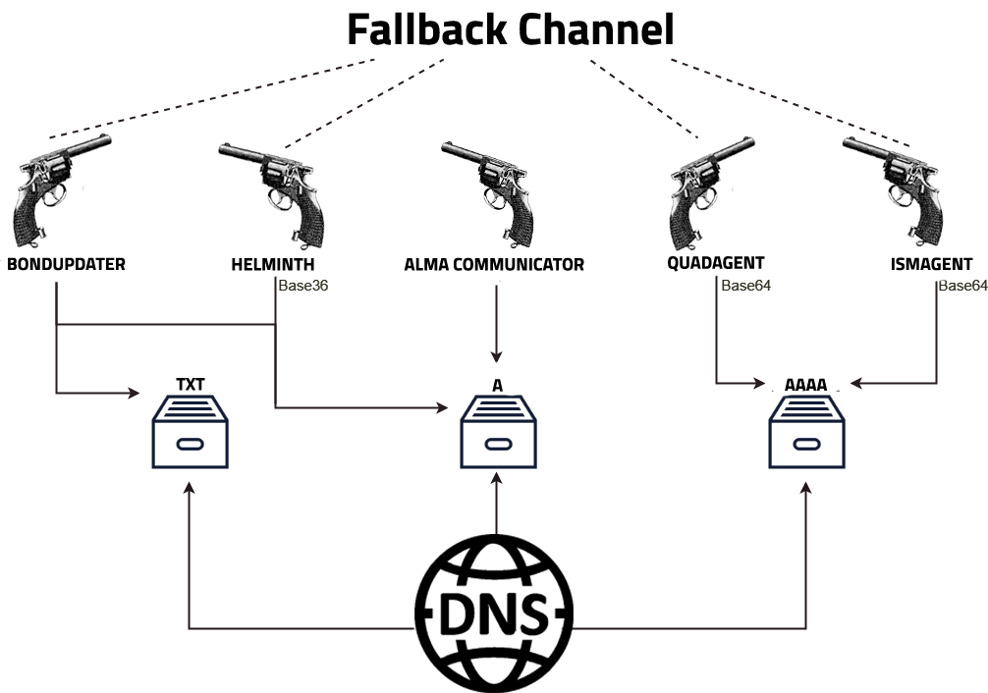

Slide 25
ONE APT TO RULE THEM ALL
Sea Turtle
DNSpionage Suspected Iranian
OilRig Targets Saudi Arabia with Helminth
Project Sauron
FIN7 Targets Restaurant Industry
OilRig Uses QUADAGENT
DNSpionage
APT32 Targets Southeast Asia
RogueRobin
New Variant
NetNod
Compromised
FrameworkPoS
FIN7 Targets US SEC
Multigrain
OSX/MaMi
Switcher
OilRig Uses BONDUPDATER
APT32 Targets Cambodian interested people
OilRig Uses ISMInjector
BlackWallet.co Loses $400K
2016
2017
2018
2019
BernhardPoS
DNSMessenger
UDPoS
Kessel
DNS Hijacking in Venezuela
Cafax
Attacked
DNSUnlocker
OilRig Uses ISMAgent
DarkHydrus Uses RogueRobing
Denis Backdoor
US CERT Global Alert
Roaming Mantis New Variant
OilRig expands Targets
APT32 Targets Subsidiaries of US and Philippines
DNSpionage launches Karkaroff
OilRig Targets Middle East
Roaming Mantis
OilRig Uses ALMA Communicator

Slide 26
Project Sauron
Suspected
United States
ESPIONAGE
Strategic
-[
Once Upon a Time

Slide 27
-[
The Guns
]-
Project Sauron
Real-time status reporting
T1005 - Data from Local System
T1132 - Data Encoding (Base64 encoding)
T1094 - Custom Command and Control Protocol (DNS Tunneling)

Slide 28
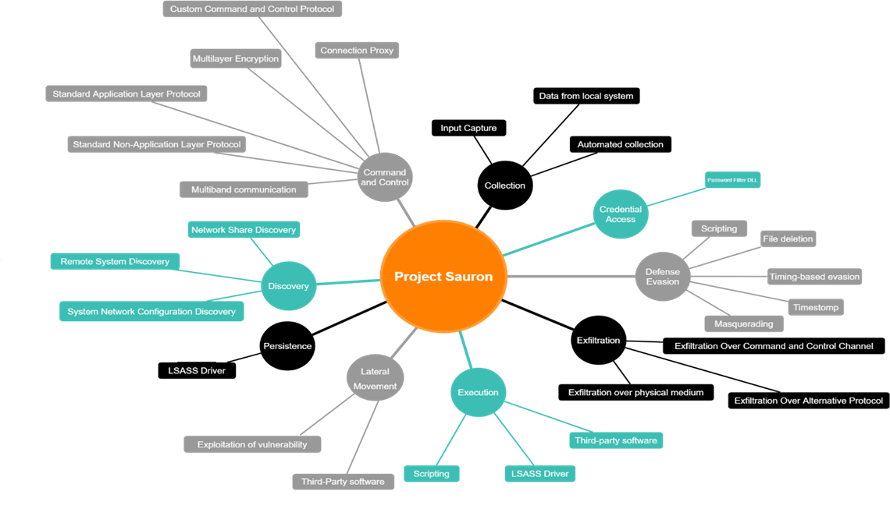

Slide 29
DARKHYDRUS APT
Sea Turtle
DNSpionage Suspected Iranian
OilRig Targets Saudi Arabia with Helminth
Project Sauron
FIN7 Targets Restaurant Industry
OilRig Uses QUADAGENT
DNSpionage
APT32 Targets Southeast Asia
RogueRobin
New Variant
NetNod
Compromised
FrameworkPoS
FIN7 Targets US SEC
Multigrain
OSX/MaMi
Switcher
OilRig Uses BONDUPDATER
APT32 Targets Cambodian interested people
OilRig Uses ISMInjector
BlackWallet.co Loses $400K
2016
2017
2018
2019
BernhardPoS
DNSMessenger
UDPoS
Kessel
DNS Hijacking in Venezuela
Cafax
Attacked
DNSUnlocker
OilRig Uses ISMAgent
DarkHydrus Uses RogueRobing
Denis Backdoor
US CERT Global Alert
Roaming Mantis New Variant
OilRig expands Targets
APT32 Targets Subsidiaries of US and Philippines
DNSpionage launches Karkaroff
OilRig Targets Middle East
Roaming Mantis
OilRig Uses ALMA Communicator

Slide 30
DarkHydrus
Suspected Iranian
MILITARY & POLITICAL ADVANTAGE
Expert
-[
Once Upon a Time

Slide 31
-[
The Guns
]-
DarkHydrus – RogueRobin
T1193 - Spearphishing Attachment
T1059 - Command-Line Interface
T1132 - Data Encoding (Base64 encoding)
T1094 - Custom Command and Control Protocol (DNS A, AAAA, CNAME, TXT, SRV, SOA records)

Slide 32
POINT OF SALE
Sea Turtle
DNSpionage Suspected Iranian
OilRig Targets Saudi Arabia with Helminth
Project Sauron
FIN7 Targets Restaurant Industry
OilRig Uses QUADAGENT
DNSpionage
APT32 Targets Southeast Asia
RogueRobin
New Variant
NetNod
Compromised
FrameworkPoS
FIN7 Targets US SEC
Multigrain
OSX/MaMi
Switcher
OilRig Uses BONDUPDATER
APT32 Targets Cambodian interested people
OilRig Uses ISMInjector
BlackWallet.co Loses $400K
2016
2017
2018
2019
BernhardPoS
DNSMessenger
UDPoS
Kessel
DNS Hijacking in Venezuela
Cafax
Attacked
DNSUnlocker
OilRig Uses ISMAgent
DarkHydrus Uses RogueRobing
Denis Backdoor
US CERT Global Alert
Roaming Mantis New Variant
OilRig expands Targets
APT32 Targets Subsidiaries of US and Philippines
DNSpionage launches Karkaroff
OilRig Targets Middle East
Roaming Mantis
OilRig Uses ALMA Communicator

Slide 33


-[
DNS Attack History
]-
Security affairs - Trustwave analyzed of point-of-sale malware
1234567812345678.attacker-domain.com
Point
of Sale
Hijacked
BernhardPoS & FrameworkPoS
First cases reported
Multigrain and UDPOS
Steal credential card information

Slide 34
FIN7
Sea Turtle
DNSpionage Suspected Iranian
OilRig Targets Saudi Arabia with Helminth
Project Sauron
FIN7 Targets Restaurant Industry
OilRig Uses QUADAGENT
DNSpionage
APT32 Targets Southeast Asia
RogueRobin
New Variant
NetNod
Compromised
FrameworkPoS
FIN7 Targets US SEC
Multigrain
OSX/MaMi
Switcher
OilRig Uses BONDUPDATER
APT32 Targets Cambodian interested people
OilRig Uses ISMInjector
BlackWallet.co Loses $400K
2016
2017
2018
2019
BernhardPoS
DNSMessenger
UDPoS
Kessel
DNS Hijacking in Venezuela
Cafax
Attacked
DNSUnlocker
OilRig Uses ISMAgent
DarkHydrus Uses RogueRobing
Denis Backdoor
US CERT Global Alert
Roaming Mantis New Variant
OilRig expands Targets
APT32 Targets Subsidiaries of US and Philippines
DNSpionage launches Karkaroff
OilRig Targets Middle East
Roaming Mantis
OilRig Uses ALMA Communicator

Slide 35
FIN7
Suspected Eastearn European
FINANCIAL GAIN
Innovator
-[
Once Upon a Time

Slide 36
-[
The Guns
]-
DNS MESSENGER a.k.a Powersource
Public tool DNS_TXT_Pwnage
T1027 - Obfuscated Files or Information
T1132 - Data Encoding (Base64 encoding)
T1094 - Custom Command and Control Protocol (DNS A and TXT Records)

Slide 37


Slide 38
ANDROID HIJACKING
Sea Turtle
DNSpionage Suspected Iranian
OilRig Targets Saudi Arabia with Helminth
Project Sauron
FIN7 Targets Restaurant Industry
OilRig Uses QUADAGENT
DNSpionage
APT32 Targets Southeast Asia
RogueRobin
New Variant
NetNod
Compromised
FrameworkPoS
FIN7 Targets US SEC
Multigrain
OSX/MaMi
Switcher
OilRig Uses BONDUPDATER
APT32 Targets Cambodian interested people
OilRig Uses ISMInjector
BlackWallet.co Loses $400K
2016
2017
2018
2019
BernhardPoS
DNSMessenger
UDPoS
Kessel
DNS Hijacking in Venezuela
Cafax
Attacked
DNSUnlocker
OilRig Uses ISMAgent
DarkHydrus Uses RogueRobing
Denis Backdoor
US CERT Global Alert
Roaming Mantis New Variant
OilRig expands Targets
APT32 Targets Subsidiaries of US and Philippines
DNSpionage launches Karkaroff
OilRig Targets Middle East
Roaming Mantis
OilRig Uses ALMA Communicator

Slide 39
APT32 A.K.A. OCEANLOTUS
Sea Turtle
DNSpionage Suspected Iranian
OilRig Targets Saudi Arabia with Helminth
Project Sauron
FIN7 Targets Restaurant Industry
OilRig Uses QUADAGENT
DNSpionage
APT32 Targets Southeast Asia
RogueRobin
New Variant
NetNod
Compromised
FrameworkPoS
FIN7 Targets US SEC
Multigrain
OSX/MaMi
Switcher
OilRig Uses BONDUPDATER
APT32 Targets Cambodian interested people
OilRig Uses ISMInjector
BlackWallet.co Loses $400K
2016
2017
2018
2019
BernhardPoS
DNSMessenger
UDPoS
Kessel
DNS Hijacking in Venezuela
Cafax
Attacked
DNSUnlocker
OilRig Uses ISMAgent
DarkHydrus Uses RogueRobing
Denis Backdoor
US CERT Global Alert
Roaming Mantis New Variant
OilRig expands Targets
APT32 Targets Subsidiaries of US and Philippines
DNSpionage launches Karkaroff
OilRig Targets Middle East
Roaming Mantis
OilRig Uses ALMA Communicator

Slide 40
OceanLotus
Suspected Vietnamese
ESPIONAGE
Innovator
-[
Once Upon a Time

Slide 41
-[
The Guns
]-
OceanLotus – Denis Backdoor
T1193 - Spearphishing Attachment
DNS Responses 4 bytes
T1094 - Custom Command and Control Protocol (DNS A and NULL records)
T1132 - Data Encoding (Base 32 encoding)

Slide 42
GLOBAL ALERT!
Sea Turtle
DNSpionage Suspected Iranian
OilRig Targets Saudi Arabia with Helminth
Project Sauron
FIN7 Targets Restaurant Industry
OilRig Uses QUADAGENT
DNSpionage
APT32 Targets Southeast Asia
RogueRobin
New Variant
NetNod
Compromised
FrameworkPoS
FIN7 Targets US SEC
Multigrain
OSX/MaMi
Switcher
OilRig Uses BONDUPDATER
APT32 Targets Cambodian interested people
OilRig Uses ISMInjector
BlackWallet.co Loses $400K
2016
2017
2018
2019
BernhardPoS
DNSMessenger
UDPoS
Kessel
DNS Hijacking in Venezuela
Cafax
Attacked
DNSUnlocker
OilRig Uses ISMAgent
DarkHydrus Uses RogueRobing
Denis Backdoor
US CERT Global Alert
Roaming Mantis New Variant
OilRig expands Targets
APT32 Targets Subsidiaries of US and Philippines
DNSpionage launches Karkaroff
OilRig Targets Middle East
Roaming Mantis
OilRig Uses ALMA Communicator

Slide 43
DNSpionage
Suspected Iranian
ESPIONAGE
Expert
-[
Once Upon a Time

Slide 44
-[
The Guns
]-
DNSpionage – Toolset
T1192 - Spearphishing Link
T1008 – Fallback Channels
T1094 - Custom Command and Control Protocol (DNS A record)
T1132 - Data Encoding (Custom Base 64 alphabet)

Slide 45



-[
DNS Attack History
]-
Global DNS Hijacking
US CERT ALERT
DNS REDIRECTOR
DNS A RECORDS
DNS NS RECORDS
Let’s Encrypt Certificates

Slide 46
Sea Turtle
Unkown Origin
MILITARY & POLITICAL ADVANTAGE
Strategic
-[
Once Upon a Time

Slide 47
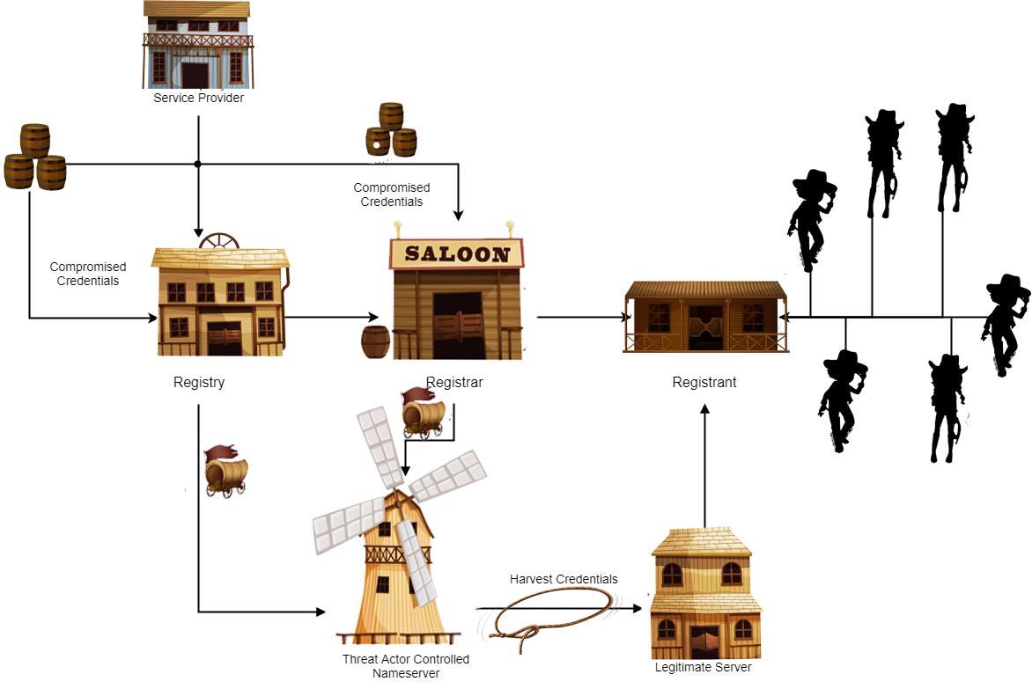

Slide 48


Guns In Data

Slide 49
-[
Guns In Data
]-
DNS Hijacking Common Techniques
T110 – BRUTE FORCE
T1199 – TRUSTED RELATIONSHIP
T1078 – VALID ACCOUNT
Access to accounts when passwords are unknown or when password hashes are obtained
Adversaries may breach or otherwise leverage organizations who have access to intended victims
Steal or capture credentials of user or service account earlier in the reconnaissance process

Slide 50
-[
Guns In Data
]-
DNS Tunneling Common Techniques
78%
50%
42%
36%
T1193 – Spear-phishing Attachments
T1053 – Scheduled Task
T1086 – PowerShell
T1008 – Fallback Channels
Spear-phishing emails with malicious macro in document relying on user execution
WTS to execute programs at system startup or on a scheduled basis for persistence
Executed PowerShell script or used PowerShell to execute commands sent by C2
Alternate communication channels if the primary is compromised or inaccesible
Deloitte Internal Sources*

Slide 51
-[
The Guns
]-
DNS Tunneling
Preference for A Records
Base64 encoding
IP Addresses as binary, hex adecimal or ASCII data

Slide 52

-[
Dodging The Bullets
]-
Let’s Do Better
GENERAL RECOMENDATIONS
Monitor Internet Traffic
Change default configurations in routers
MFA on domain’s admin portal
Validate source IPs in OWA/ Exchange logs
Use access control list for applications
Unique passwords and password Managers

Slide 53


Slide 54
-[
Dodging The Bullets
]-
Let’s Do Better
DNS HIJACKING
Use Secure DNS
(DNSSEC, DNSCrypt, DNS Over TLS, DNS Over HTTPS)
Review your accounts configurations
Validate A and NS record changes
Implement Registry Lock
Review SSL certificates

Slide 56
-[
Dodging The Bullets
]-
Let’s Do Better
DNS TUNNELING
Monitor DNS Traffic and DNS server logs (ELK + BRO IDs)
Avoid Internal hosts resolution to external domain. Use proxy
Have a separate set of recursive servers for your mail servers
Block >512 bytes TCP and UDP >1024 bytes packets
Block TXT and NULL records*
Install a IDS/IPS like Snort or Suricata
Combine dnsmasq and DNS whitelisting policies

Slide 58



-[
Questions & Answers
]-
THANK YOU!
Valentina Palacín @fierytermite
Ruth Esmeralda Barbacil @33root

Slide 59
Bibliography
Schouwenberg, Roel (April 5, 2005). Increasing cases of DNS poisoning being spotted. Available at: https://securelist.com/increasing-cases-of-dns-poisoning-being-spotted/29988/
Wikipedia (January 5, 2007). Connecticut v. Amero. wikipedia.org Available at: https://en.wikipedia.org/wiki/Connecticut_v._Amero
Hacquebord, Feike (August 7, 2008). ZLOB Enters The Search Engine Market. Available at: https://blog.trendmicro.com/trendlabs-security-intelligence/zlob-enters-the-search-engine-market/
Lanstein, Alex (February 17, 2009). Bad Actors Part 3 - Internet Path/Cernel. Available at: https://www.fireeye.com/blog/threat-research/2009/02/bad-actors-part-3-internet-pathcernel.html

Slide 60
Guevarra Carolyn (January 14, 2010). Iranian “Cyber Army” Strikes at China’s Search Engine Giant, Chinese Hackers Retaliate. Available at: https://blog.trendmicro.com/trendlabs-security-intelligence/iranian-cyber-army-strikes-at-chinas-search-engine-giant-chinese-hackers-retaliate/
Golovanov, Sergey (June 3, 2011). TDSS loader now got “legs” Available at: https://securelist.com/tdss-loader-now-got-legs/30844/
Assolini, Fabio (November 7, 2011) Massive DNS poisoning attacks in Brazil. Available at: https://securelist.com/massive-dns-poisoning-attacks-in-brazil-31/31628/
Baumgartner, Kurt (March 2, 2012). DNSChanger – Cleaning Up 4 Million Infected Hosts Available at: https://securelist.com/dnschanger-cleaning-up-4-million-infected-hosts-2/32191/
Preuss, Marco (July 6, 2012) The end of DNS-Changer. Available at: https://securelist.com/the-end-of-dns-changer-12/33132/

Slide 61
Bestuzhev, Dmitry (July 10, 2012) Is it the end of the DNSChanger Trojan? Available at: https://securelist.com/is-it-the-end-of-the-dnschanger-trojan-17/33429/
Assolini, Fabio ( October 1, 2012) The Tale of One Thousand and One DSL Modems. Available at: https://securelist.com/the-tale-of-one-thousand-and-one-dsl-modems/57776/
Tanase, Stefan (November 28, 2012) Google.ro and RO domains Victims of Possible DNS Hijacking. Available at: https://securelist.com/google-ro-and-ro-domains-victims-of-possible-dns-hijacking/57668/
M.Léveillé, Marc-Etienne (May 7, 2013) Linux/Cdorked.A malware: Lighttpd and nginx web servers also affected. Available at: https://www.welivesecurity.com/2013/05/07/linuxcdorked-malware-lighttpd-and-nginx-web-servers-also-affected/
Meyers, Adams (August 30, 2013) DNS – The Lifeblood of your Domain. Available at: https://www.crowdstrike.com/blog/dns-lifeblood-your-domain/

Slide 62
M.Léveillé, Marc-Etienne (February 1, 2014) An In-depth Analysis of Linux/Ebury. Available at: https://www.welivesecurity.com/2014/02/21/an-in-depth-analysis-of-linuxebury/
Vanheuverzwijn, Benjamin(April 1, 2014) Win32/Sality newest component: a router’s primary DNS changer named Win32/RBrute Available at: https://www.welivesecurity.com/2014/04/02/win32sality-newest-component-a-routers-primary-dns-changer-named-win32rbrute/
Ned Moran, Joshua Homan, Mike Scott (August 6, 2014) Available at: https://www.fireeye.com/blog/threat-research/2014/08/operation-poisoned-hurricane.html
Assolini, Fabio (September 2, 2014) Web-based attack targeting home routers, the Brazilian way. Available at: https://securelist.com/web-based-attack-targeting-home-routers-the-brazilian-way/66358/
Martin, Alan (November 1, 2014) Craigslist redirected to prank site via DNS hijack. Available at: https://www.welivesecurity.com/2014/11/25/craigslist-redirected-prank-site-via-dns-hijack/

Slide 63
Kozy, Adam (February 23, 2015) Cyber Kung-Fu: The Great Firewall Art of DNS Poisoning. Available at. https://www.crowdstrike.com/blog/cyber-kung-fu-great-firewall-art-dns-poisoning/
Lee, Bryan (June 10, 2015) APT Group UPS Targets US Government with Hacking Team Flash Exploit. Available at: https://unit42.paloaltonetworks.com/apt-group-ups-targets-us-government-with-hacking-team-flash-exploit/
Xiao, Claud (October 4, 2015) YiSpecter: First iOS Malware That Attacks Non-jailbroken Apple iOS Devices by Abusing Private APIs. Available at: https://unit42.paloaltonetworks.com/yispecter-first-ios-malware-attacks-non-jailbroken-ios-devices-by-abusing-private-apis/
Sudeep Singh, Yin Hong Chang (May 22, 2016) Targeted Attacks against Banks in the Middle East. Available: https://www.fireeye.com/blog/threat-research/2016/05/targeted_attacksaga.html
Falcone, Robert(May 26, 2016) The OilRig Campaign: Attacks on Saudi Arabian Organizations Deliver Helminth Backdoor. Available at: https://unit42.paloaltonetworks.com/the-oilrig-campaign-attacks-on-saudi-arabian-organizations-deliver-helminth-backdoor/

Slide 64
Guest (Jun 2016) Crouching Tiger, Hidden DNS. Available at: https://www.welivesecurity.com/2016/06/02/crouching-tiger-hidden-dns/
Cian Lynch, Dimiter Andonov, Claudiu Teodorescu (June 19, 2016) MULTIGRAIN – Point of Sale Attackers Make an Unhealthy Addition to the Pantry. Available at: https://www.fireeye.com/blog/threat-research/2016/04/multigrain_pointo.html
GReAT (August 8, 2016) ProjectSauron: top level cyber-espionage platform covertly extracts encrypted government comms. Available at: https://securelist.com/faq-the-projectsauron-apt/75533/
GReAT ( August 9, 2016) THE PROJECTSAURON APT Available at: https://media.kasperskycontenthub.com/wp-content/uploads/sites/43/2018/03/07190154/The-ProjectSauron-APT_research_KL.pdf
Grunzweig, Josh (October 1, 2016) OilRig Malware Campaign Updates Toolset and Expands Targets. Available at: https://unit42.paloaltonetworks.com/unit42-oilrig-malware-campaign-updates-toolset-and-expands-targets/

Slide 65
Buchka, Nikita (December 28, 2016) Switcher: Android joins the ‘attack-the-router’ club. Available at: https://securelist.com/switcher-android-joins-the-attack-the-router-club/76969/
Brumaghin, Edmun (March 2, 2017) Covert Channels and Poor Decisions: The Tale of DNSMessenger. Available at: https://blog.talosintelligence.com/2017/03/dnsmessenger.html
Steve Miller, Jordan Nuce, Barry Vengerik (March 7, 2017) FIN7 Spear Phishing Campaign Targets Personnel Involved in SEC Filings. Available at: https://www.fireeye.com/blog/threat-research/2017/03/fin7_spear_phishing.html
Carr, Nick (May 14, 2017) Cyber Espionage is Alive and Well: APT32 and the Threat to Global Corporations. Available at: https://www.fireeye.com/blog/threat-research/2017/05/cyber-espionage-apt32.html
Gorelik, Michael (June 9, 2017) FIN7 takes another bite at the restaurant industry. Available at: http://blog.morphisec.com/fin7-attacks-restaurant-industry
Falcone, Robet (July 27, 2017) OilRig Uses ISMDoor Variant; Possibly Linked to Greenbug Threat Group. Available at: https://unit42.paloaltonetworks.com/unit42-oilrig-uses-ismdoor-variant-possibly-linked-greenbug-threat-group/

Slide 66
Falcone, Robert (October 9, 2017) OilRig Group Steps Up Attacks with New Delivery Documents and New Injector Trojan. Available at: https://unit42.paloaltonetworks.com/unit42-oilrig-group-steps-attacks-new-delivery-documents-new-injector-trojan/
Brumaghin, Edmun (October 11, 2017) Spoofed SEC Emails Distribute Evolved DNSMessenger. Available at: https://blog.talosintelligence.com/2017/10/dnsmessenger-sec-campaign.html
Falcone, Robert (November 8, 2017) OilRig Deploys “ALMA Communicator” – DNS Tunneling Trojan. Available at: https://unit42.paloaltonetworks.com/unit42-oilrig-deploys-alma-communicator-dns-tunneling-trojan/
Caspi, Ofer ( 2019) Mami. Available at: https://macos.checkpoint.com/families/Mami/
Sergey Yunakovsky, Ilya Pomerantsev (January 25, 2018) Denis and Co. Available at: https://securelist.com/denis-and-company/83671/
The Cylance Threat Research Team ( February 27, 2018) Threat Spotlight: Inside UDPoS Malware. Available at: https://threatvector.cylance.com/en_us/home/threat-spotlight-inside-udpos-malware.html

Slide 67
The Clyance Team (February 27, 2018) Protect VS Udpos. Available at: https://threatvector.cylance.com/en_us/home/cylance-vs-udpos-malware.html
Bill Marczak, Nicholas Weaver, Jakub Dalek, Roya Ensafi, David Fifield, Sarah McKune, Arn Rey, John Scott-Railton, Ron Deibert, and Vern Paxson ( April 10, 2015) China’s Great Cannon. Available at: https://citizenlab.ca/2015/04/chinas-great-cannon/
Eset (Mach, 2018) OceanLotus Old techniques, new backdoor. Available at: https://www.welivesecurity.com/wp-content/uploads/2018/03/ESET_OceanLotus.pdf
Ishimaru, Suguru (April 16, 2018) Roaming Mantis uses DNS hijacking to infect Android smartphones. Available at: https://securelist.com/roaming-mantis-uses-dns-hijacking-to-infect-android-smartphones/85178/
Ishimaru, Suguru (May 18, 2018) https://securelist.com/roaming-mantis-dabbles-in-mining-and-phishing-multilingually/85607/
Lee, Brian (July 25, 2018) OilRig Targets Technology Service Provider and Government Agency with QUADAGENT. Available at: https://unit42.paloaltonetworks.com/unit42-oilrig-targets-technology-service-provider-government-agency-quadagent/

Slide 68
Falcone, Robert and Lee, Brian.(July 27, 2018) New Threat Actor Group DarkHydrus Targets Middle East Government Available at: https://unit42.paloaltonetworks.com/unit42-new-threat-actor-group-darkhydrus-targets-middle-east-government/
Wilhoit, Kyle (September 12, 2018) OilRig Uses Updated BONDUPDATER to Target Middle Eastern Government. Available at: https://unit42.paloaltonetworks.com/unit42-oilrig-uses-updated-bondupdater-target-middle-eastern-government/
GReAT (October 1, 2018) Roaming Mantis, part III Available at: https://securelist.com/roaming-mantis-part-3/88071/
Deloitte Interal Sources (October 30, 2018) Canadian Energy company Suncor targeted with "AgentDrable" RAT [Not available for the public]
ESET Research White papers (December, 2018) The Dark Side of The ForSSHE Available at: https://www.welivesecurity.com/wp-content/uploads/2018/12/ESET-The_Dark_Side_of_the_ForSSHe.pdf

Slide 69
Fois, Quentin (January 11, 2019) Threat Actor “Cold River”: Network Traffic Analysis and a Deep Dive on Agent Drable. Available at: https://www.lastline.com/labsblog/threat-actor-cold-river-network-traffic-analysis-and-a-deep-dive-on-agent-drable/
Harán, Juan Manuel (January 23, 2018) Nueva variante del troyano RogueBin utiliza Google Drive como Comando y Control. Availbale at: https://www.welivesecurity.com/la-es/2019/01/23/troyano-roguebin-utiliza-google-drive-comando-control/
Muks Hirani, Sarah Jones, Ben Read (January 9, 2019) Global DNS Hijacking Campaign: DNS Record Manipulation at Scale. Available at: https://www.fireeye.com/blog/threat-research/2019/01/global-dns-hijacking-campaign-dns-record-manipulation-at-scale.html
Dahl, Matt (January 25, 2019) Widespread DNS Hijacking Activity Targets Multiple Sectors. Available at: https://www.crowdstrike.com/blog/widespread-dns-hijacking-activity-targets-multiple-sectors/
GReAT (February 13, 2019) DNS Manipulation in Venezuela in regards to the Humanitarian Aid Campaign. Available at: https://securelist.com/dns-manipulation-in-venezuela/89592/

Slide 70
Dumont, Romain (March 1, 2019) Fake or Fake: Keeping up with OceanLotus decoys. Available at: https://www.welivesecurity.com/2019/03/20/fake-or-fake-keeping-up-with-oceanlotus-decoys/
Mercer, Warren (April 17, 2019) DNS Hijacking Abuses Trust In Core Internet Service. Available at: https://blog.talosintelligence.com/2019/04/seaturtle.html
Mercer, Warren (April 23, 2019) DNSpionage brings out the karkoff. Available at: https://blog.talosintelligence.com/2019/04/dnspionage-brings-out-karkoff.html
GReAT (April 3, 2019) Roaming Mantis IV. Available at: https://securelist.com/roaming-mantis-part-iv/90332/

